Slide 1
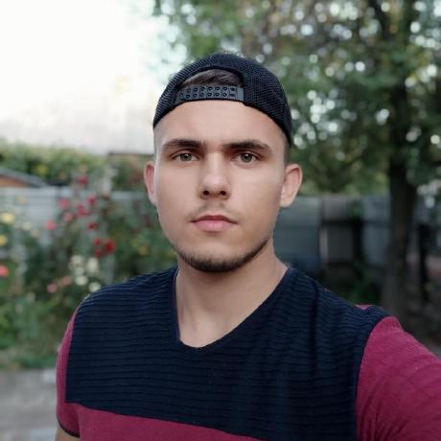
.NET Developer Krupko Taras
Personal info
Tech Skills
Soft skills
Age: 19 City: Kyiv Phone: +380951397343 Email: taras.krupko07@gmail.com LinkedIn: linkedin.com/in/krupkotaras GitHub: github.com/Break-1T
C#
WPF
Entity Framework
MVVM
OOP
MS SQL (basic understanding)
GIT
Teamwork
Time management

Slide 2
About myself
I am a beginner .NET developer. Moderately sociable, constantly trying to develop in my field and ready to learn something new. I can communicate fluently in Russian and Ukrainian, and also speak English quite well at the level of reading and perception. I have experience with GIT. At the moment I am looking for a job to consolidate my knowledge and acquire new ones.

Slide 3
Education and languages
Kiev National University of Trade and Economics, Software engineering. 2019-2023.
Ukrainian – fluently
Russian – fluently
English - intermediate

Slide 4
Pet projects
• StoreApp (.NET 5.0, WPF, Entity Framework, MVVM) StoreApp is an application for product and personnel management. There is a database that can be edited by the administrator through the graphical interface. • Calculation_of_penalties (.NET 3.1, WPF, MVVM) Coursework for calculating penalties for unpaid court decisions. The software provides the user with the ability to calculate the amount of alimony for a certain period. It is possible to save and load intermediate calculations, as well as output data to an Excel file.

